Slide 1
The Social Dilemma
Sam Gould, Rose McGovern, Jarius Thomas, Pheobe Yeung

Slide 2
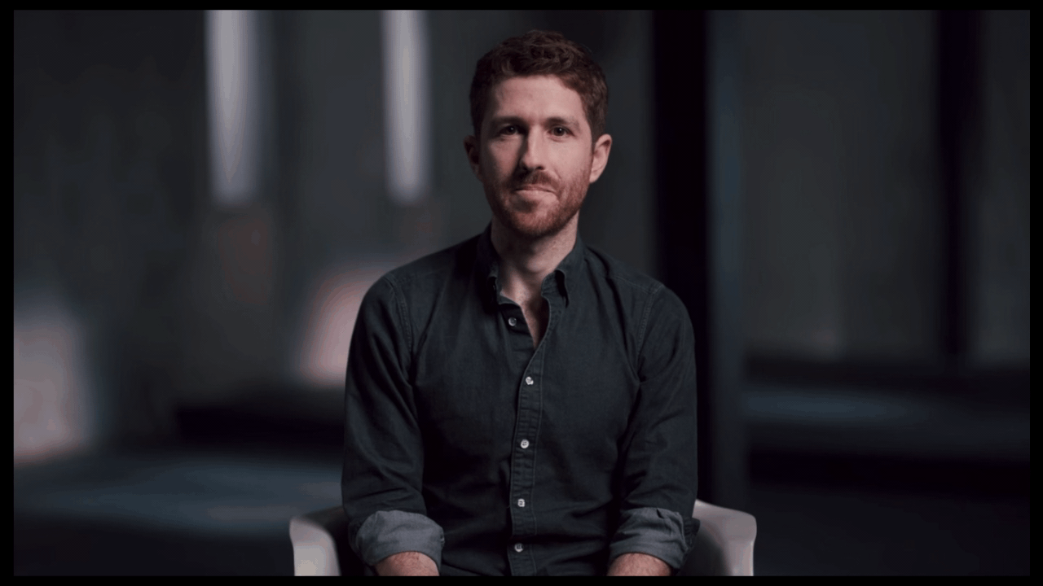
Summary
Docu-drama
Half interviews with disillusioned industry professionals
Half a drama showing the issues discussed
“We need to program with morality”
Tristan Harris, Former Google Design Ethicist, laughs when asked what the problem with social media is.
Notes:
S
The social dilemma is docu-drama, meaning that it is part documentary and part drama. The documentary half is made up of interviews with disillusions tech industry professionals, many of them former executives of big companies including facebook and pinterest. They explain the issues that they know of in the social media industry, all surrounding the unethical design of features, such as how they are made to be addictive.
As the movie switches between the documentary part and the drama part, the fictional story aligns with the issues they are talking about in the interviews.

Slide 3
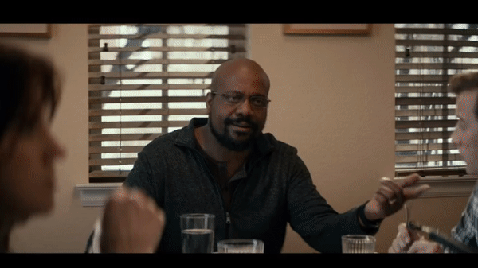
Summary - Drama
Family
Youngest child (Isla) is addicted to her phone
Middle child (Ben) is less addicted to his phone
Oldest child (Cassandra) doesn’t have a smartphone
Challenged to give up cell phones
Isla smashes the Kitchen Safe to get her phone back
Notes:
R
The drama storyline follows a family of 5 that has 3 teenage children. The oldest daughter, Cassandra, is completely against social media, the middle son, Ben, is a frequent user of social media, and the youngest daughter, Isla, is obsessed with social media. Throughout the movie the oldest daughter tries to persuade her siblings to get off social media and tries to persuade her mom to regulate this usage. There are two instances where the younger two children are challenged to give up their phones. The first you can see in the video on the right, where the mom has everyone put their phones in a timed safe for 1 hour so that they can eat dinner without interruptions. This only lasts for a few minutes before Isla, the youngest daughter, leaves the dinner table to go smash the safe open and get her phone. In the process of smashing the safe, she cracks Ben, the middle childs phone screen. His mom then challenges him to leave his phone in the kitchen and to not use it for a week, in exchange for a new screen. Ben agrees to this, but then breaks the challenge a few days later when he notices a notification about his ex girlfriend. And once he breaks the challenge he then starts using his phone again on an obsessive level.

Slide 4
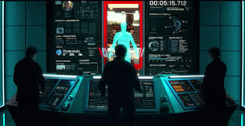
Summary - Drama
Algorithm of social media is dramaticized as people selectively choosing content and pop ups
Algorithm pushed conspiracy content to middle child
Went to protest
Got himself & older sister arrested
These three characters represent the behind-the-scenes algorithms that create Ben’s social media feeds
Notes:
S
The other key part of the drama side of the movie is how it creates this fictional universe where there are real physical people controlling Ben, the middle childs, phone. They represent the way that social media algorithms are designed to work, where they study every move he makes on social media and analyze it to determine his interests, moods, and areas of weakness where they can prey on him to boost his engagement. The strategically send push notifications based on the people around him, to keep his on his phone, and will push content that they know will change his behavior. At one point the people inside of Ben’s phone auction off ad space on his social media feeds, to demonstrate the how social media users are being “used” by tech companies as they make money from their advertisements.
Another big plot point is when Ben indicates interest in a conspiracy theory and the people inside of his phone immediately begin to push extreme center political content all over his feed. He becomes completed encapsulated in this topic and begins to disengage with the people around him and even stops going to his soccer practices. This leads to him attending a protest where Cassandra, his older sister, spots him while driving by and when she gets out of her car to get him they both get arrested.

Slide 5
Director’s Intent
Highlight the issues in social media
Unethical business models
Addictive
Highlight the ways social media and the internet are geared to influence real-world behaviors
Jeff Orlowski, Director of The Social Dilemma(2020)[4]
Notes:
Rose
This film was directed by Jeff Orlowski. The director's intent was to highlight the issues in social media by using reputable sources as interviewees to gain trust in the viewers and to almost shock them a little as they can see how former employees feel about the industry, and by using fictional storyline to create relatable content that helps demonstrate how this affects everyone in their normal lives.
The director makes it a point to highlight how the social media industry is corrupt as companies have unethical business models that are designed only to make more money, without considering their users and how the addictiveness of their products affect our society. And while social media is online, it is made to affect real world behaviors, which has an impact greater than most people realize. The technology that connects us , also manipulates, controls, polarizes, distracts, monetizes, and divides us.

Slide 6
Main Takeaways
We watched the movie...now what?
Notes:
R
Moving on to our main takeaways from the movie...

Slide 7
The Business Model is Predatory and Infringes on Human Rights.
Notes:
J
Our first conclusion is that the business model is predatory on users
---------

Slide 8
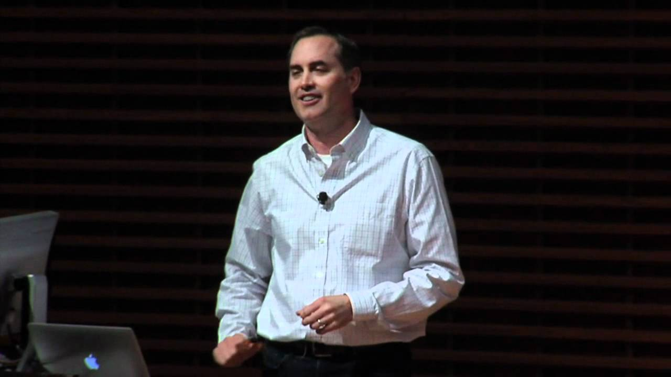
Social Media is Made to be Addictive
Stanford Persuasive Technology Lab
Engineers trained to use “the psychology of what persuades people” in the systems they create
“We want to modify someone’s behavior. We want them to take this action...”
Positive Intermittent Reinforcement
Harris created a presentation on the addictive aspect of Gmail, and its ethical impact
This presentation was rapidly spread throughout Google, even to CEO Larry Page, yet it furnished no results
The business model requires user attention to sell more ad space
B.J. Fogg, a professor whose course at the Stanford University Persuasive Technology Lab is referenced in the film
Notes:
J
Early in the documentary, Tristan Harris refers to the curriculum taught at the stanford Persuasive Technology Lab
While this lab is no longer active at Stanford, many Silicon Valley executives responsible for the growth of companies like Facebook, Uber, Google and others passed through classes there.
Harris says he learned how “dig down into the brain stem and implant, inside of you, an unconscious habit…” at this lab
The quote about modifying behavior is also from Tristan Harris (red haired gentleman shown laughing on the first slide)
He also said Persuasive Technology is “design intentionally applied to the extreme” - the film introduces the moral dilemma created when design is applied to the extreme as Harris describes, it, and later on, our presentation circles back to this idea
To unpack this further, i want to cite one example of manipulative psychology that is intentionally applied in Big Tech design: it’s a technique called Positive Intermittent Reinforcement:
Joe Toscano (Former Experience Design Consultant @ Google) mentions in his interview the action of pulling down at the top of your feed to refresh.
“You pull down and you refresh….. It’s gonna be a new thing at the top. Pull down and refresh again, it’s new. Every single time.” - Toscano
From wikipedia: “ Whenever a rat presses a button, it gets a treat. If the rat starts pressing the button more often, the treat serves to positively reinforce this behavior. ”
Harris compares this to the slot machines in Las Vegas
As a hired Design Ethicist for a big company, Harris fulfilled his job by calling out the addictive nature of the technology he was assigned to (which at the time was Gmail). He found himself becoming addicted to it, and in response created a presentation about the impact that the few engineers at google were having on billions of people. This presentation was shared with ~20 people, but within a day it had spread throughout Google, even reaching the CEO Larry Page
The wide spread of this presentation created a few days of buzz, but no changes. Nothing happened when a man hired to call out ethical issues called out an ethical issue, because the BUSINESS MODEL REQUIRES USER ATTENTION. They need lots and lots of it, as much as feasibly possible, in order to make more money. That is the way these companies on structured - users’ attention is used as a means to make more money, and the top executives know it. They did it on purpose, by design. NEXT SLIDE

Slide 9
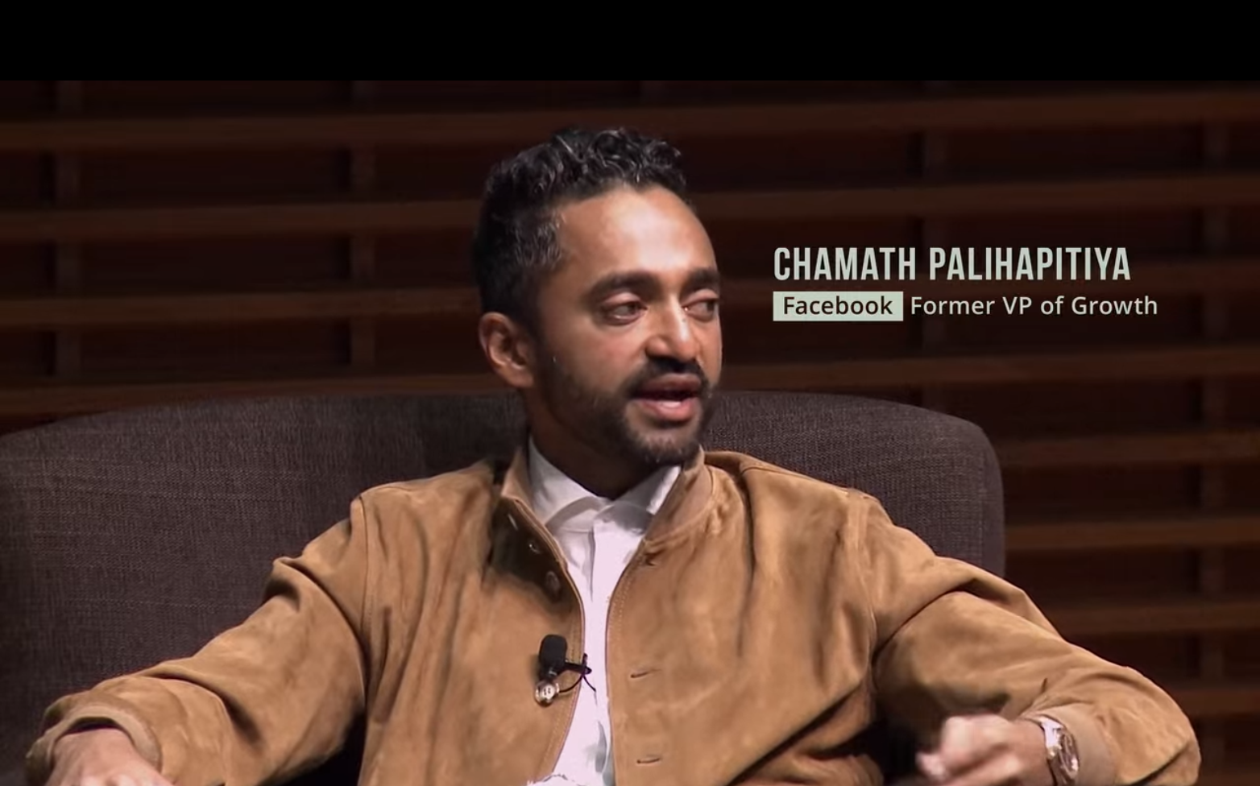
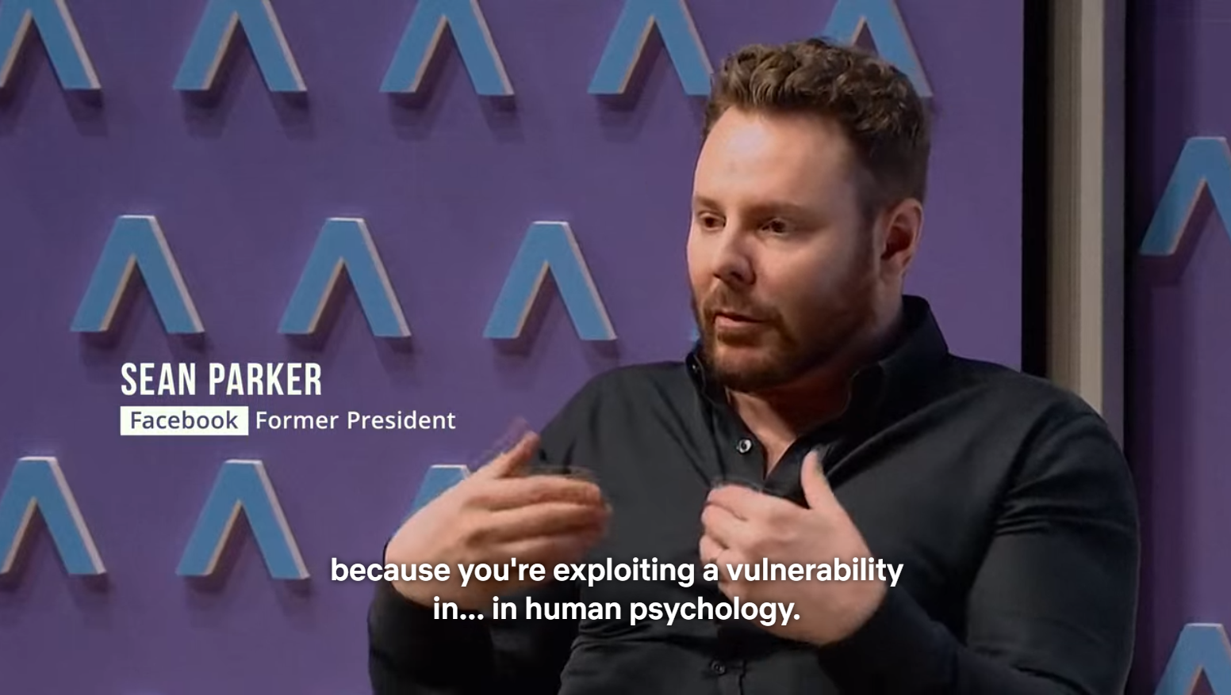
Social Media is Made to be Addictive (2)
“ We want to psychologically figure out how to manipulate you as fast as possible, and then give you back that dopamine hit.
We did that brilliantly at Facebook. Instagram has done it, WhatsApp has done it, Snapchat has done it, Twitter has done it… ”
“ it’s exactly the kind of thing that a hacker like myself would come up with, because you’re exploiting a vulnerability in human psychology.
I think that we, the inventors, creators … all of these people understood this consciously, and we did it anyway...”
-Chamath Palihapitiya
Former VP of Growth at Facebook
-Sean Parker
First President of Facebook
Notes:
J
These men offer insight into the predatory nature of Facebook’s design.
Chamath, who was the VP of growth at Facebook, was responsible for making Facebook infectious. He was the reason it blew up into the commonplace, household name that we all know todya.
He is referenced and directly mentioned by others in the movie, when they talk about the playbook Facebook used to expand its user base.
In his own words, this playbook is centered on using psychology to manipulate users as quickly as possible.
On the right, we have Sean Parker, the first president of Facebook. He goes back to the earliest iterations of Facebook, and worked alongside Mark Zuck.
He calls the techniques applied an exploitation - he says “you’re exploiting a vulnerability in human psychology. ” When he talked about who exploits human psychology, I didn’t include this in the quote (because it’s pretty long) but he actually names:
-himself,
-alongside Mark Zuckerberg and Kevin Systrom (creator of Instagram),
as people who are guilty of doing this. It’s not just some fluke, or some rogue engineer - it goes all the way to the creators of these platforms. They are just as complicit as the engineers who worked for them.

Slide 10
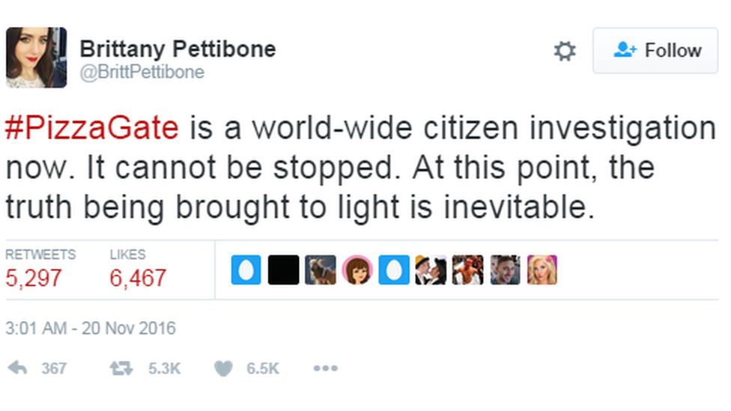
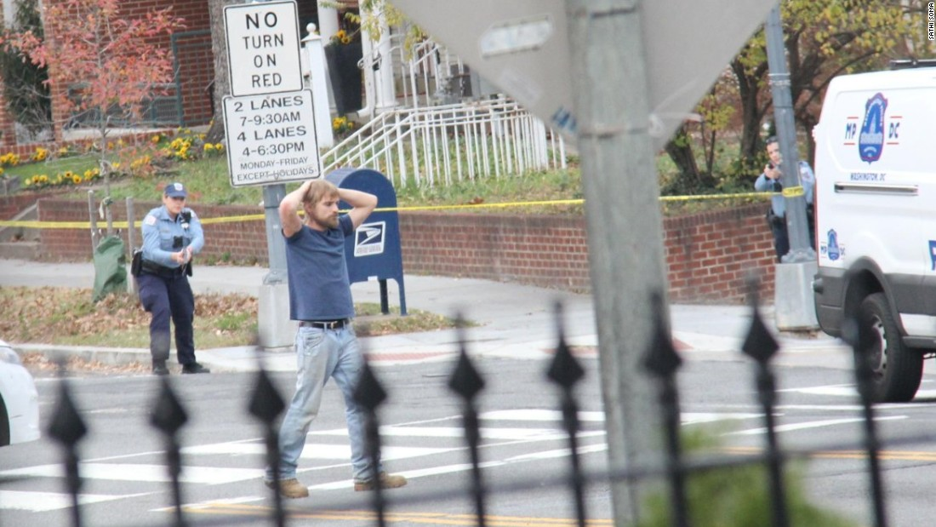
PizzaGate & Other Conspiracy/Extremist Groups
Companies are trying to make more money
Sensationalized content = more clicks
Social media helps push conspiracies, fake news, extremist content due to higher rates of engagement
MIT study: fake news spreads 6x as fast as true stories on Twitter [3]
Positive feedback creates echo chambers
(2017) The conspiracy theory known as “Pizzagate” led to a N. Carolina man invading a Washington, DC restaurant with three guns to “investigate” a basement that did not exist.
Notes:
Another tactic that is used by social media giants to gain higher foot traffic, is the allowance of conspiracy theories, fake news, and extremist group activities to exist on their platforms. Companies are able to use interactions to track, and eventually micro-target users. This infringes heavily on the fundamental right to privacy. The overarching money maker for big tech companies is data. Data that is used, without the user’s direct knowledge.
The sensationalized is also more troubling than it may initially seem. Fake news distorts and poisons democratic debate. It is one thing for millions of voters to be influenced by precisely targeted social media messages, but another for maliciously false messages to influence and manipulate millions – whether paid for or not. This undermining of truth violates our right to be informed. Despite knowing this, social media companies do not regulate misinformation as well as they should, for human beings are naturally more drawn to dramatic crazy headlines.
“The present-day online experience is biased to elevate paranoia, xenophobia, and the most irritable voices.” - Jaron Lanier
Note that Facebook recommended Pizzagate conspiracy groups to users who had never even searched “pizzagate” before
We provide examples of negative things that can happen → then shift to this question: who is responsible ?
“Think about Wikipedia… imagine for a second, if Wikipedia said we’re going to give each person a different customized definition, and we’re going to be paid by people for that…”
-Jaron Lanier Founding Father of Virtual Reality, Author of “Ten Arguments for Deleting Your Social Media Accounts Right Now”
https://news.mit.edu/2018/study-twitter-false-news-travels-faster-true-stories-0308

Slide 11
Monetization & Targeted Content
“If you don’t pay for the product, YOU are the product.”
Notes:
P
Unfortunately, allowance of incorrect content, and a business model that incentives new ways to draw people to their phones, have negative effects on our fundamental human rights. In order to get the next round of funding, in order to get your stock price up, the amount of time that people spend on your app has to go up. This is a quote that came from Aza Raskin, the inventor of infinite scroll. This is a part of why the business models of these companies are so detrimental. Raskin talks about how there are generally a thousand engineers that have worked on something to try to make it maximally addicting. The incentive behind this phenomenon is always monetary gain. Despite the negative effects social media, and the internet as a whole can have on society, money is the motivator behind the decisions being made. This mentality is perfectly captured by this quote. If you don’t pay for the product, you are the product.

Slide 12
2. Increase Regulation and Responsibility
Notes:
Someone needs to be held responsible (government, companies, programmers)
If the gov doesnt make regulations (which it should) its on us

Slide 13
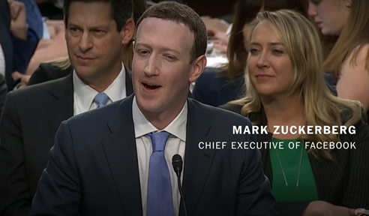
Facebook Congress Hearings
Cambridge Analytica leak
Millions of users data leaked
How aware are users of the privacy violations?
“Unless there’s a law, their business model is going to continue to maximize profit over privacy,” - Blumenthal [6]
Can tech companies regulate themselves?
Mark Zuckerberg Testifying before congress [6]
Notes:
Facebook’s CEO was called to testify before congress in 2018 in relation to the Cambridge Analytica leak
Millions of profiles/data were leaked
Discussion of internet privacy violations
Would you tell us what hotel you’re staying at? Who you’ve sent messages to this week? No? Then you should inform your users they are giving you that information
If Facebook knowingly withheld the leak, FCC violation
“The old saying: There ought to be a law. There has to be a law. Unless there’s a law, their business model is going to continue to maximize profit over privacy,” - Blumenthal
Public outcry & scandal led to increased privacy settings available on Facebook

Slide 14
Current Legislation
EU General Data Protection Regulation
Protects EU residents
Opt-in vs Opt-out
Users can delete their data [7]
California Consumer Privacy Act
Protects California residents
Right to know
Right to delete [5]
Notes:
The EU has better laws than the US (GDPR)
Protects anyone residing in EU
Data collection is opt-in rather than opt-out
Companies can’t collect data by default
EU residents can request a company delete all data collected on them
California Consumer Privacy Act
Protects anyone residing in California, not entire US
Two main rights: right to know, right to delete
Right to know
Can request a company give a copy of all data they have on you
Right to delete
Can request a company to delete all data they have collected on you
Both laws caused privacy policies to update, and while we may not live in these places, it did show all users more privacy options

Slide 15
Proposed Legislation from Movie
Tax data collection
Financially penalize data collection
Data is valuable
Profit over privacy
Hit the wallet to create change
Notes:
Taxing data collection won’t stop them from collecting data, but will stop them from collecting data unless they need to
Currently, financially incentivizing data collection
Can’t make data collection illegal, but make it less valuable and it should protect privacy
Machine learning models require a lot of data, but reducing less effective variables doesn’t necessarily make the model much worse
Would force companies to collect only the most valuable data

Slide 16
3. There should be social implication requirements for technology majors.
Notes:
Pheobe
The last take away from this movie is that there is a need for social implication requirements, if someone is in a technology major. This need was brought to light by Tristan Harris, an ex-employee of Google. He said that he realized the fact that his work heavily impacts a lot of people. One decision on a font, is seen by millions on their phone in an instant. Harris’s co-workers were shocked at his revelation, but he was ultimately ignored when he tried to bring this issue up with his superiors at Google. If our class saw the presentation that Harris presented his findings with, I doubt that many of us will be shocked. This entire term, we have learned about the responsibility we have to society. We have learned about morals, and been asked hard hypotheticals to decide what is right and wrong. As it currently stands, there are not many colleges that have a social implications requirement for their computer science majors. This is a huge gap that needs to be filled, because the future generations need to be educated on the impact that they are making. If every single engineer in the tech industry was required to take the class that we are in, maybe Harris’s presentation would have been able to do more. It is essential that the next generation really understand that with great power comes great responsibility.

Slide 17
Questions?
?

Slide 18
References
The Social Dilemma(2020) directed by Jeff Orlowski.
https://thriveglobal.com/stories/four-arguments-for-deleting-your-social-media-accounts/
https://news.mit.edu/2018/study-twitter-false-news-travels-faster-true-stories-0308
http://www.jefforlowski.com/biography
Dean, Sam. “It's 2020 and You Have New Privacy Rights Online. But You Might Have to Show ID.” Los Angeles Times, Los Angeles Times, 1 Jan. 2020, www.latimes.com/business/technology/story/2020-01-01/ccpa-california-internet-rights-what-you-need-know.
The New York Times. “Mark Zuckerberg Testimony: Senators Question Facebook's Commitment to Privacy.” The New York Times, The New York Times, 10 Apr. 2018, www.nytimes.com/2018/04/10/us/politics/mark-zuckerberg-testimony.html.
Shahani, Aarti. “3 Things You Should Know About Europe's Sweeping New Data Privacy Law.” NPR, NPR, 24 May 2018, www.npr.org/sections/alltechconsidered/2018/05/24/613983268/a-cheat-sheet-on-europe-s-sweeping-privacy-law.

