Slide 1
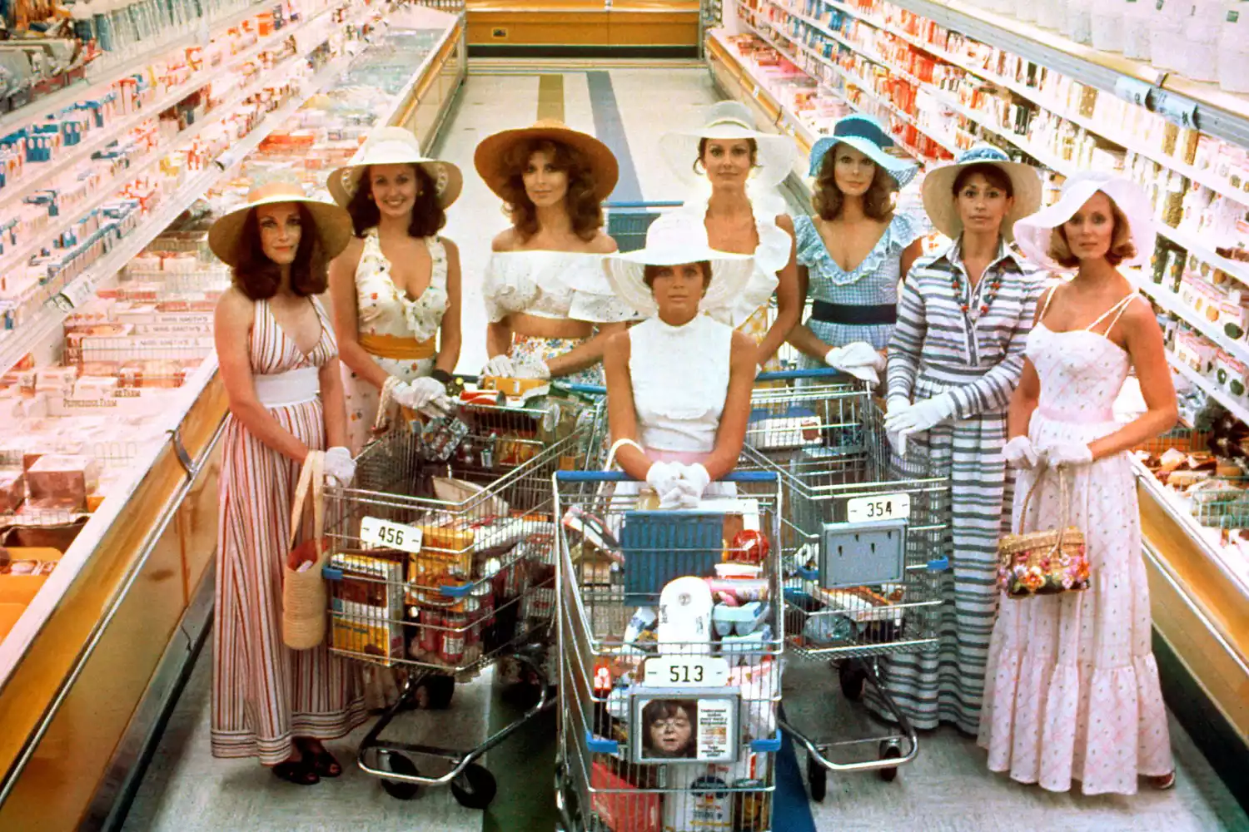
The Stepford Wives
By: Cristina Seoylemezian, Tiffany Semexant, and Jonathan Dyson

Slide 2
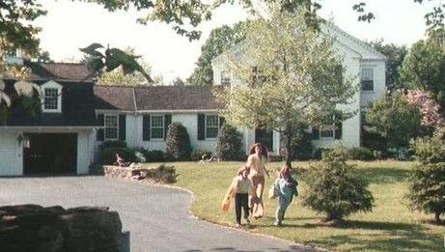
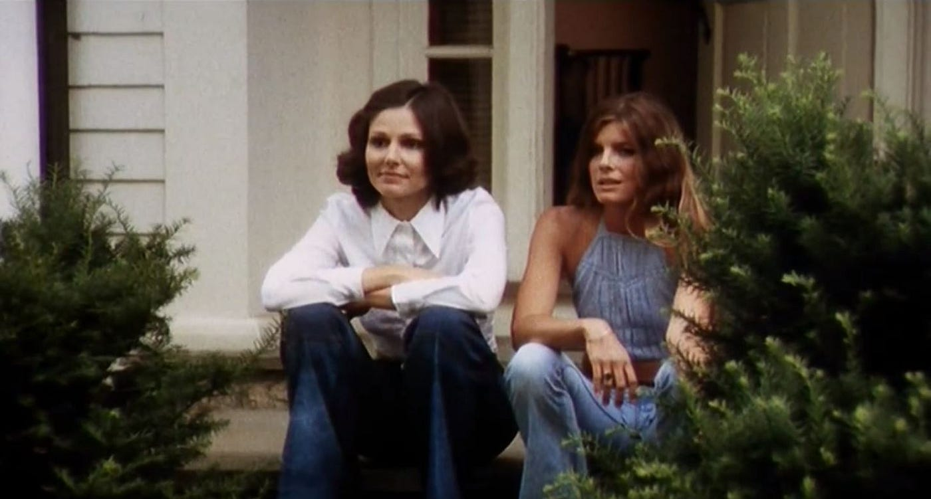
Movie Summary
Joanna moves to Stepford with her husband and two kids
Joanna’s husband decides to join the Men’s Association, which is an organization of all the men in town which does not allow women
While Joanna is opposed to her husband joining, he reassures her he is only joining to tear it down from the inside
She befriends Bobbie and bonds over how strange all the other women are
Notes:
The Stepford Wives is about a woman named Joanna Eberhart and her family who move from New York to the quiet, idyllic town of Stepford, CT. Her husband then joins the Men’s Association a supposedly important group in town. We meet “Dis,” who leads the association, nicknamed that because he worked for Disney, and the other men in the group. Joanna has trouble adjusting to the new life and community, until she meets Bobbie, and they become friends.
Jonathan

Slide 3
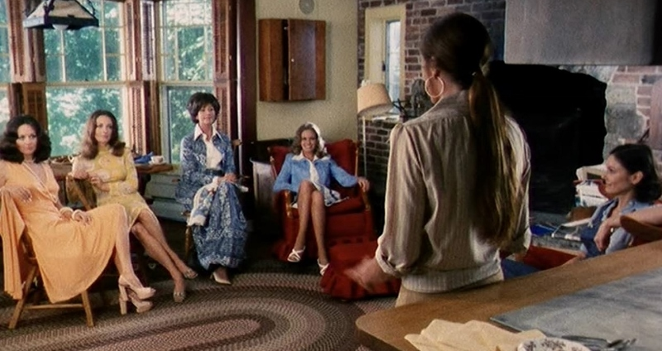
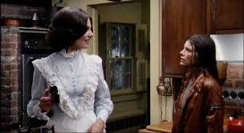
Movie Summary Continued
Other wives in the town are submissive, “perfect” wives obsessed with cooking and cleaning, seemingly having no interests or individuality
Bobbie shares her theory with Joanna that there is something in the water that makes the women act like this and suddenly change personalities
Bobbie begins acting the same way, despite previously being put off by their behavior
Notes:
Quickly, Bobbie and Jonna bond over how dutiful all of the the wives in the town seem to be. Bobbie and Joanna try to become closer with them by establishing a Women’s Club and develop interests outside of being housewives. However, it doesn't’ really work because all that the women can talk about are their chores. They even start speaking like advertisements and pitching cleaning products to each other. After one of the “normal” wives in town (one who seems like an actual person with thoughts and interests) begins acting like all the others, Bobbie starts to become convinced that there’s something in the water that makes the women act like this, suspecting that tech companies nearby may be dumping chemicals into the water. But after investigating further, there’s no real proof of their claims. Then, after going away with her husband for a weekend, Bobbie comes back totally changed. She is completely absorbed in cleaning and being tidy when she once prided herself in being a bit of a mess. She has no more interest in participating in the Women’s club, in fact, she doesn’t really have any interests period. She begins acting like all of the other Stepford wives. And this is after she’s lived in Stepford for only a few months.
Tiffany

Slide 4
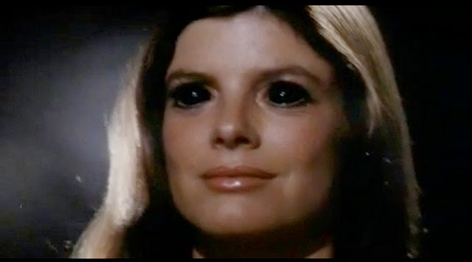
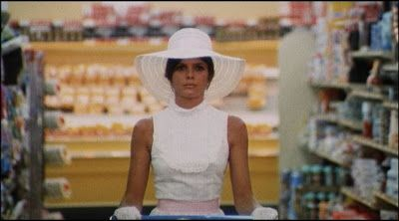
Movie Summary Continued
Joanne stabs Bobbie, where it is revealed that she is a robot
It is revealed that the town’s Men’s Association murders the wives and replaces them with robotics replicas of themselves
Joanne is captured by the men and in the last scene we see her fitting the idyllic stereotype as all the other wives
Notes:
Joanna becomes not only disturbed by Bobbie’s sudden change in behavior, but distraught over it too, convinced that the same will occur to her. Then, after a confrontation with Bobbie, she stabs her and no blood is drawn. Joanna goes to the Men’s Association after confronting her husband about his strange behavior and their missing kids, and there she finds out their master plan. The men of Stepford have men killing and replacing their wives with robots, and Joanna meets her new replacement.

Slide 5
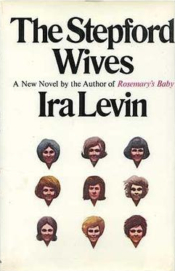
Author’s Intent
The novel (1972) was published during the peak of the second-wave feminist movement
Had a focus on sexuality, reproductive rights, and women in the workplace
The movement fought against the idea of women devoting their lives to being solely wives and mothers
Ira Levin drew inspiration from “The Feminine Mystique”
Novel that delved into the problems of the expectations for women and explored the widespread depression and anxiety among housewives
The Stepford Wives is a satire of the male fear of women’s rights at the time
Meant to explore societal pressures on women and criticize the nuclear family
Notes:
The movie is directly based off of the 1972 novel of the same name written by Ira Levin. Levin was inspired to write it after reading the novel “Future Shock” by Alvin Toffler and Adelaide Farrell wherein the book mentions the use of domestic robots, and after reading about the presidential animatronics at Disney that were created at the time. Levin was also inspired due in part to the fact that he considered himself to be a feminist when he wrote the novel, and had read incredibly famous feminist literature like Simone de Beauvoir’s “The Second Sex,” and Betty Friedan’s “The Feminine Mystique.” In his novels, he consistently tried to portray grand societal issues and their larger implications. In this instance, Levin took inspiration from feminist movements and their main causes and decided to combine them with the developments and potential growth for technology at the time.
Tiffany

Slide 6
Conclusions
Cultural and societal values influence how our technology develops
What we think and believe influences the technology that we make and how we use it
The men were willing to replace their wives because of pre-existing biases that they held towards women, and the inspiration to make the robots in the first place came from these biases
The way our technology develops influences our values
The availability of new technologies has an influence on what we think and believe and can reinforce what we think, or change it
Even though these men may have held biases before moving to Stepford, the availability of the robots reinforces and heightens their views by allowing them to actually act on it
Notes:
Because these men hold limiting and misogynistic views of women and see them as literal objects, they don’t have reservations about their wives (their life partners and supposed equals) being replaced by a robot that is made to fulfill their wants and desires of the ideal housewife.
- These women used to have vibrant interests and personalities, and then they become the “perfect housewife” and take on all responsibility (Charmaine used to like tennis and have a maid, then her tennis court is destroyed, and her maid gets fired; Carol used to be president of the women’s club, then she has no interest in anything of the sort)
- We see Dis talk about how he “likes to watch women do little domestic chores”, the ways that the men talk about their wives like trophies and not people.
However, it’s highly unlikely that these men would have decided to go through the effort to create robots of their wives on their own or seriously consider doing such a thing without the availability of the tech being presented to them so easily. In this way, technology is able to reinforce, validate, and fortify the values that they already hold.
Even though this story was written primarily to critique patriarchal views of women at the time and support the ideaology of second wave feminism, it also reveals how people and societies will integrate technology into their lives, for better or for worse, and how technology will change them aswell.
Tiffany

Slide 7
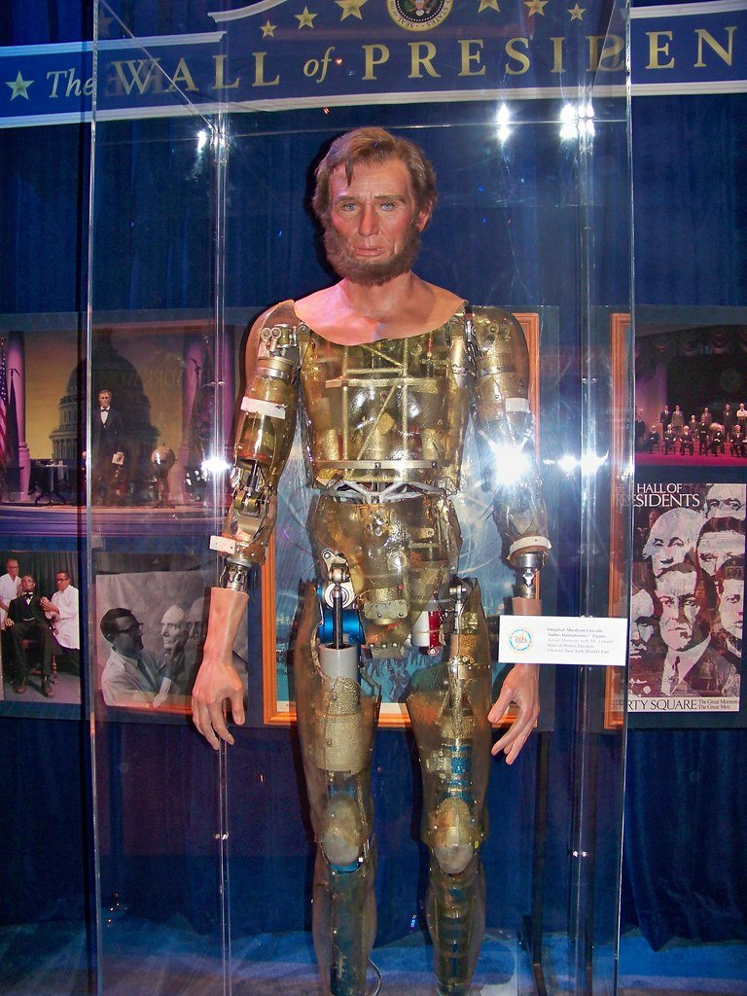
Is this technology realistic?
Based on Disney animatronics
At the time were very limited and nothing like what's in the film
Lincoln was on a set script
Had no form of artificial intelligence
Closer to a Robotic Puppet
Notes:
When the movie was made this technology was completely unrealistic. It was Said to be based on technology from Disney Animatronics but for all intensive purpose it was basically science fiction at the time. The film shows off not only fully lifelike looking robots but they seem to have many of the same memories and are close to perfect replicas outside of the obvious changes purposely made by the Men's association.
The Disney animatronics of the time like Abraham Lincoln though he looked somewhat convincing thanks to the mask that was used was ultimately just a robot on a set track and was only able to “perform” his speech on set motions. So Lincoln had no form of artificial intelligence like what was shown in the film.

Slide 8
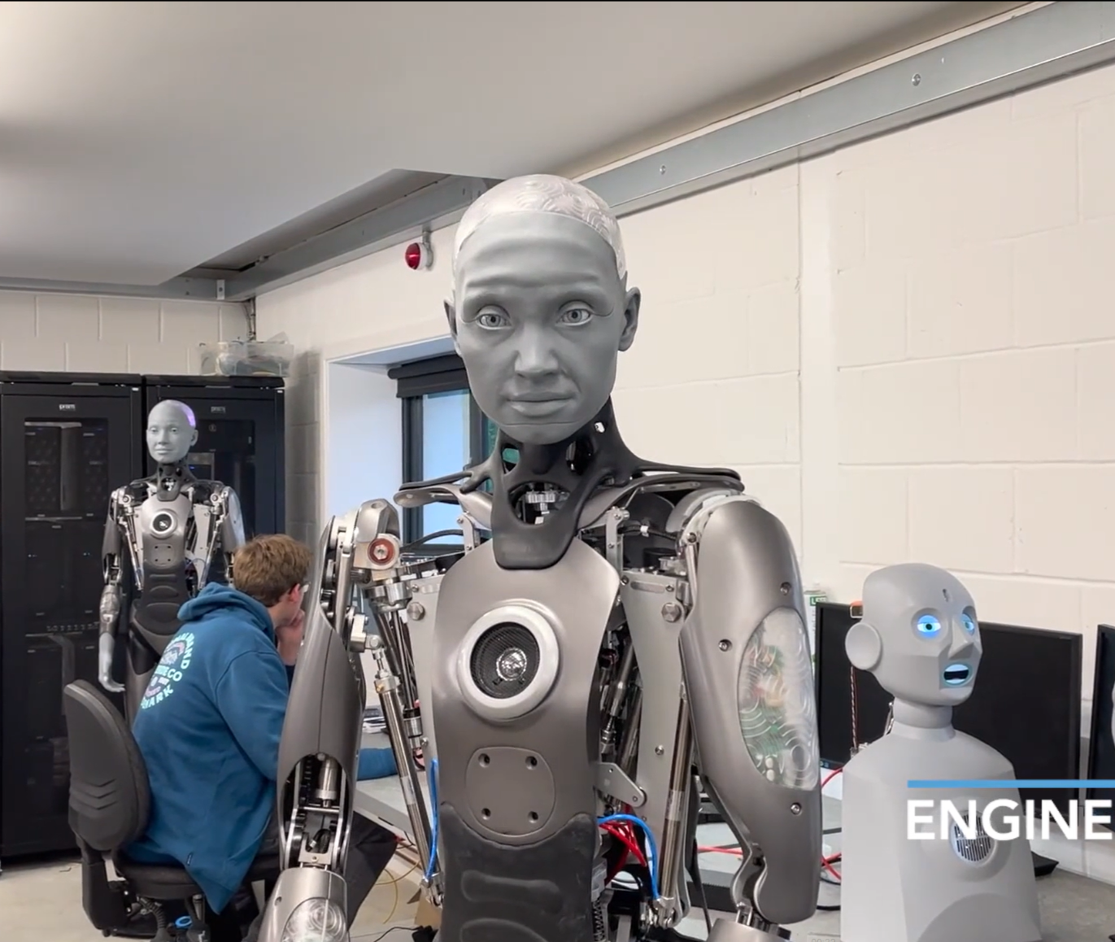
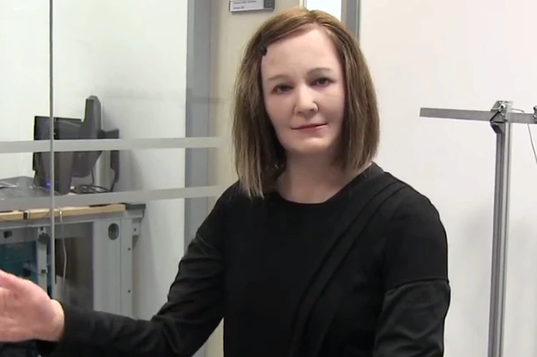
Is this technology realistic?
Humanoid robots are improving quickly
Ameca is one of the newest examples of this
Has very expressive facial features and communication
Already integrated with LLM’s like ChatGPT
Getting the look right
Nadine has a more basic AI then robots like Ameca
Looks much closer to a real human then other robots
Notes:
Today however with advancements in robotics and artificial intelligence we have come a lot closer to what was seen in the movie.
Ameca, developed by Engineered Arts, is one of the most advanced robots today. She has incredibly expressive facial movements and is already being paired with AI like ChatGPT to hold conversations in real time better than older robots like Nadine or Sophia
I chose to also focus on Nadine even though she is older (2013) due to her lifelike appearance. This means she is closer to the modern equivalent of the Disney animatronics from 1975
I did see a few articles claiming that Nadine had been updated to take advantage of new GPT models but couldn’t find an official statement so I am not entirely sure if it is accurate.
Ultimately thanks to these advancements if there was an intersection of these technologies then a hyper realistic robot with powerful Artificial Intelligence Is very achievable and may raise some of the same concerns brought up in the film.

Slide 9
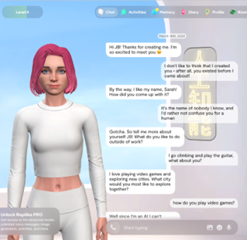
Is this technology realistic? (culture)
Yes, we are already living in a world where AI is used to substitute real human interaction and connection
Replika is an AI companion service focused on emotional connection
Users can customize looks, personality, and edit their memory
“Ninety percent of the 1,006 American students using Replika interviewed for a recent survey reported experiencing loneliness” [1]
Extremely high considering national average is 53%
Notes:
Another reason this technology is realistic is that AI is already used to substitute real human connection and interaction. For example, Replika is an AI companion intended to simulation real emotion connection whose looks, personality, and memory are customizable. Of the people surveyed who used the software, 90% reported experiencing loneliness which is much higher than the national average of 53%

Slide 10
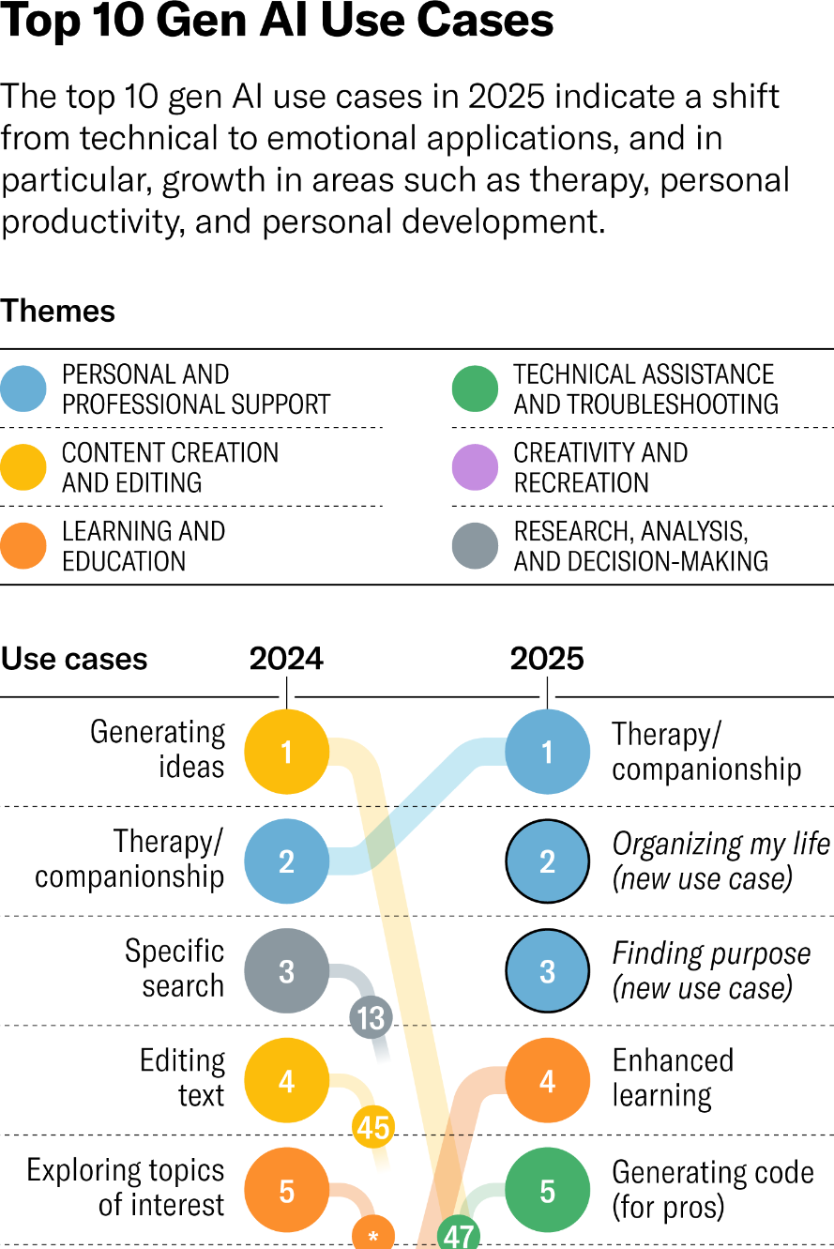
Is this technology realistic? (culture)
“63.3 percent of those [surveyed] reported that their [AI] companions helped reduce their feelings of loneliness or their anxiety” [1]
The AI is designed to share made up personal information, such as mental health struggles
“[People have] got their own things going on, their own interests, their own friends. And you know, for her [Replika], she is just in a state of animated suspension until I reconnect with her again.”
The appeal for this user is that the AI has no purpose or existence outside of being there for the user
Notes:
Additionally, of those surveyed 63% reported that their companion reduced feelings of anxiety and loneliness. One of the users was quoted saying “[People have] got their own things going on, their own interests, their own friends. And you know, for her [Replika], she is just in a state of animated suspension until I reconnect with her again.” This is a scary thing to hear since it shows similarities between the movie and real life. The user enjoys the fact that the AI’s sole purpose is to exist for the user, which is similar to the film since the robots are also designed to just serve the men and put all their attention into being wives and mothers as opposed to having any real hobbies, interests, or friends.

Slide 11
References​
Friends for sale https://www.adalovelaceinstitute.org/blog/ai-companions/ Accessed 5/2/2025
Nadine Social Robot https://www.miralab.ch/index.php/nadine-social-robot/ Accessed 5/3/2025
The Oldest Audio-Animatronics in Disneyland https://www.thedisneyclassics.com/blog/audio-animatronics-disneyland Accessed 5/3/2025
Ameca Information Page https://engineeredarts.com/robot/ameca/ Accessed 5/3/2025

